Slide 1
Answering a Large Number of Aggregate Queries with Different Methods
Caroline Kim
Professor Gerome Miklau

Slide 2
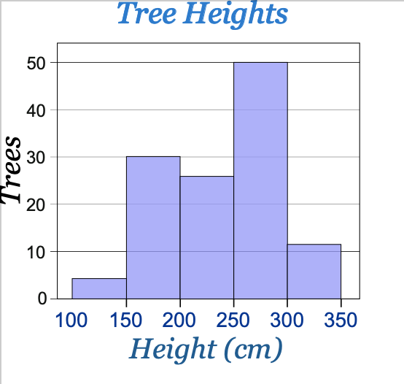
Introduction
Aggregate Queries - Counting Queries
Query that returns the number of rows that matches a specified criteria
SELECT count(*) FROM trees WHERE height = 250
Example
Histogram - representation of the distribution of numerical data

Slide 3
Introduction
Problem Statement:
To run all queries on a table when given the input of a workload of thousands of aggregate queries Q and a database which will be a single table R which gives outputs of one number for each workload query in ways that will optimize time
Methods:
RDBMS - Query at a Time
RDBMS - CUBE Query
Spark - Vectorization
Spark - MapReduce

Slide 4
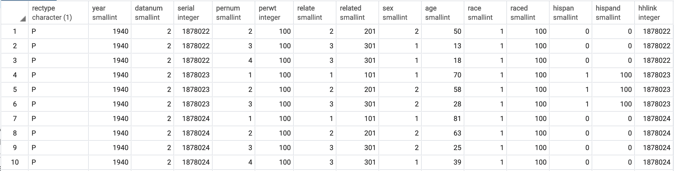
Introduction
Dataset (R):
Census Database from 1940
Person table
Workload queries refer to sex(1,2), age(0-114), race(1-6), hispan(0-4)
19,999,999 rows in total

Slide 5
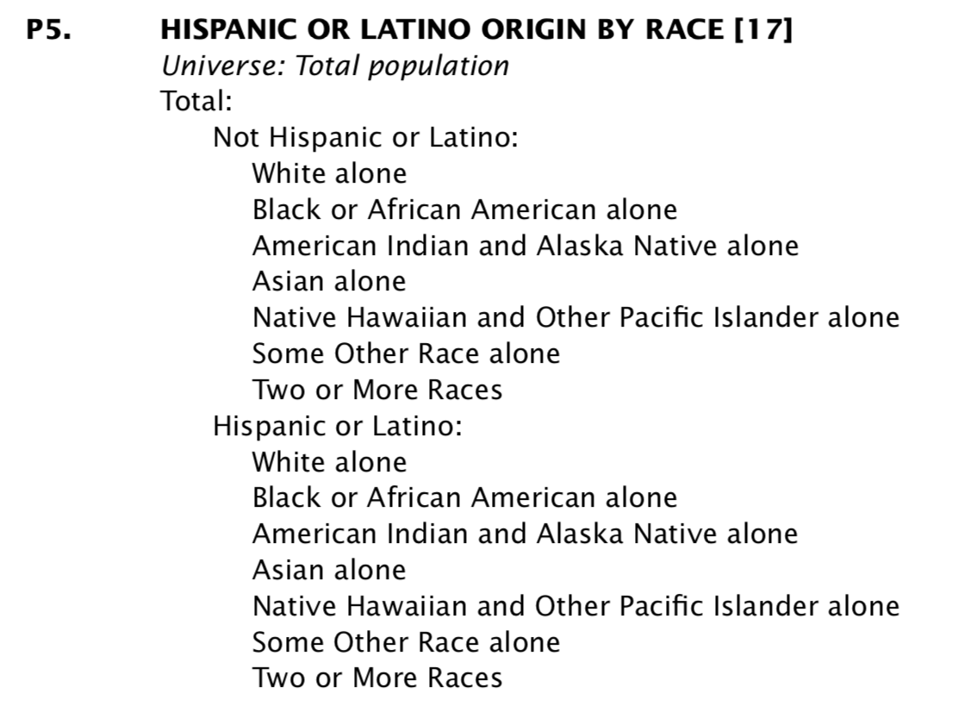
Introduction
Workload:
2010 Census Summary File
Population Table (Matrix)
Block levels in tree form
Total # of queries: 3460

Slide 6
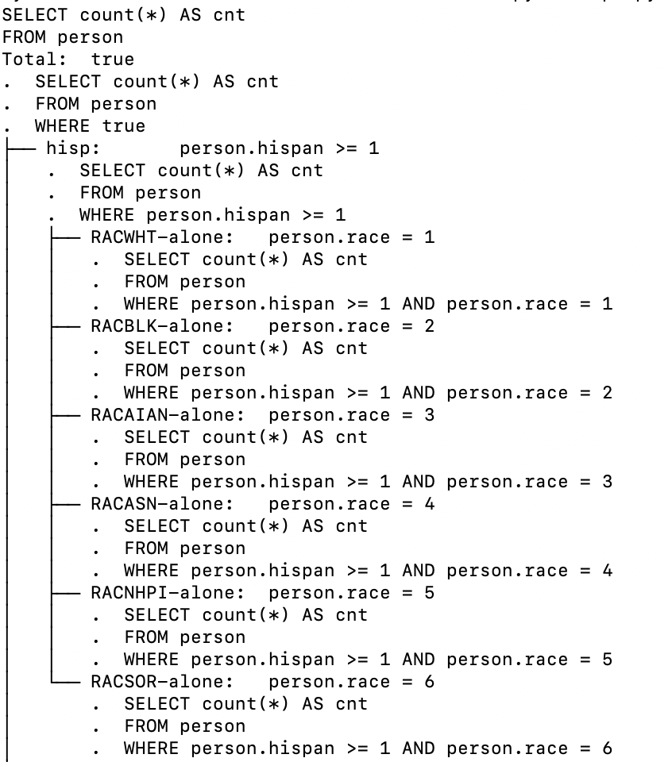
Method #1: Query at a Time
For all the queries in the workload, run SQL statement per query.
Per population table, retrieve all SQL statements, and execute them on the database

Slide 7
Method #1: Query at a Time
Results:
Query at a Time on Regular Dataset:
3 hours 33 min 41.45sec
Takes very long to retrieve answer for one query
Query at a Time on Dataset with Index:
1 hour 40 min 47.81 sec
Index on (sex, race, hispan, age) was created

Slide 8
Method #2: CUBE Query
A single SQL CUBE Query created since the CUBE function can compute many aggregates at once .
SELECT sex, race, hispan, age, count(*) FROM person GROUP BY CUBE (sex, race, hispan, age)
For all queries in the workload, the conditions are extracted out of the query and are searched in the result of the CUBE query.

Slide 9
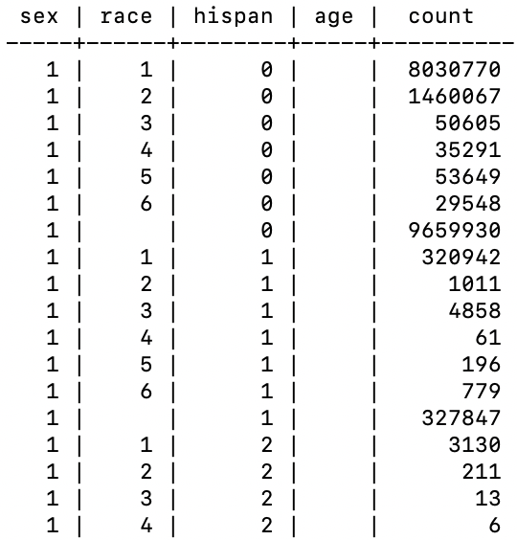
Method #2: CUBE Query
Results:
5 min 20.81 sec
Because it only created one CUBE query instead of having to create new CUBE query per matrix, it took less time.

Slide 10
Method #3: Vectorization
Dataset and Workload Vectorization:
The dataset and the workload has been vectorized.
The dataset vector is a counting vector similar to the count column from the CUBE query that corresponds to the values of sex, race, hispan, and age.
The query vector was designed to have 0 for False and 1 for True in the row where it corresponds with the right attribute.
The workload matrix is made with all the query vectors combined.

Slide 11
Method #3: Vectorization
Vector for Dataset (X):
2760 x 1
Matrix for Workload (W):
3460 x 2760
Vector per Query (w_{i}):
1 x 2760
Dot product of these two were taken. (W * X)
Vector for Output:
1 x 3460
This vector answers all the counting queries from the workload.

Slide 12
Method #3: Vectorization
Results:
34 min 42.58 sec- including the time of vectorizing the dataset
4 min 27.31 sec - only the time of calculating dot product with vectors given

Slide 13
Method #4: MapReduce
MapReduce Per Query:
Per query in the workload, each row of dataset was mapped to associated attribute. Example: [Row(sex=1, age=18, race=2, hispan=0) , 1] [Row(sex=1, age=2), 1]
The map was reduced by matching the same attribute conditions and adding the count.
Results:
2 min 50.23 sec to run on dataset with 100 rows

Slide 14
Method #4: MapReduce
One MapReduce for All:
Each row of the dataset was mapped by the 4 attributes.
The map was reduced by matching the same attribute conditions and adding the count.
Per query in the workload, all keys matching the attribute conditions were found and were added from the reducer.
Results:
1 hour 27 min 1.46 sec

Slide 15
Conclusion
Ranking of the Methods:
CUBE Query
2) Vectorization
3) MapReduce
4) Query at a Time with Index
5) Query at a Time

Slide 16
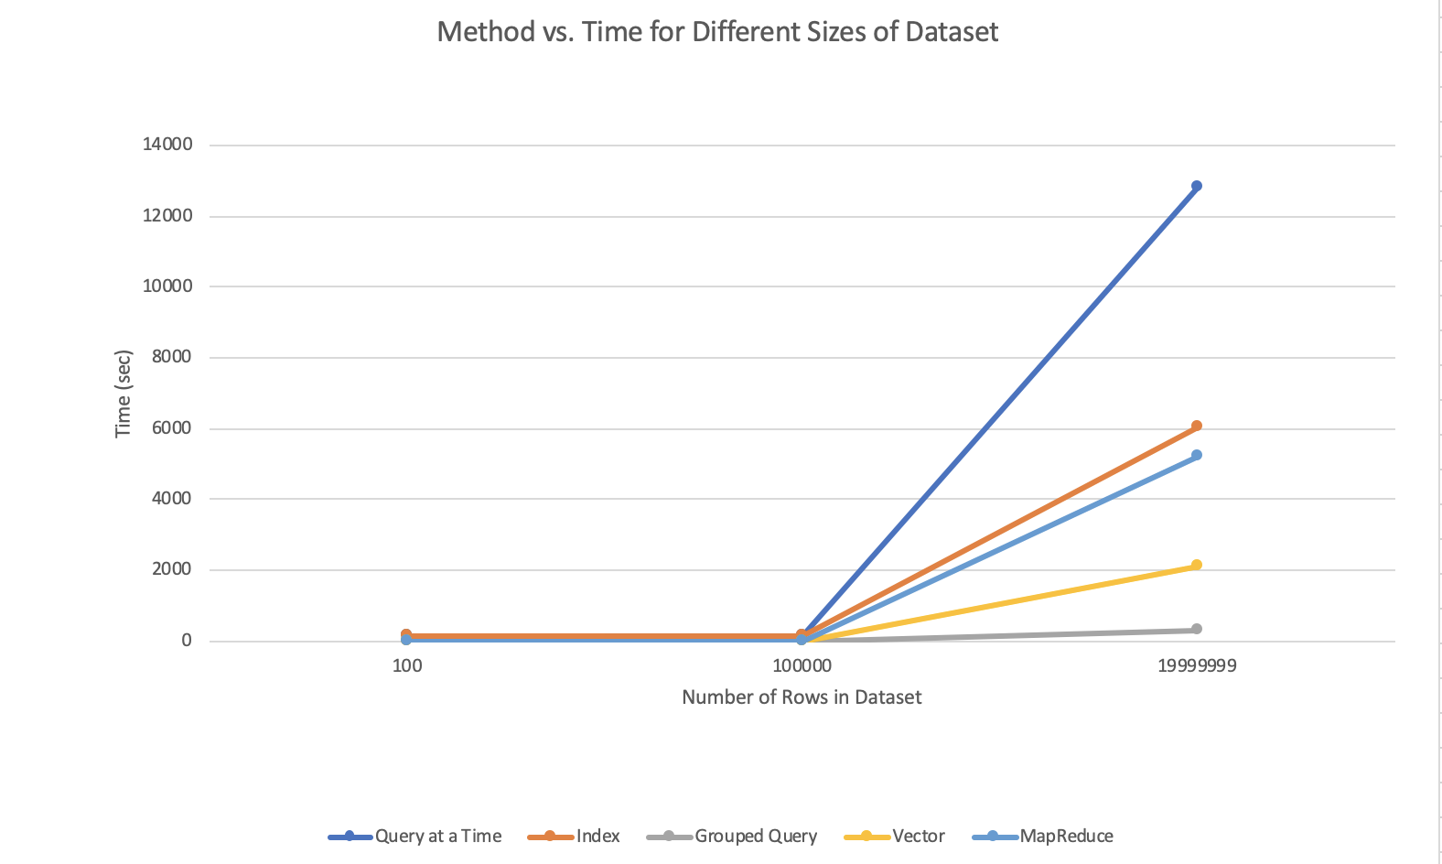
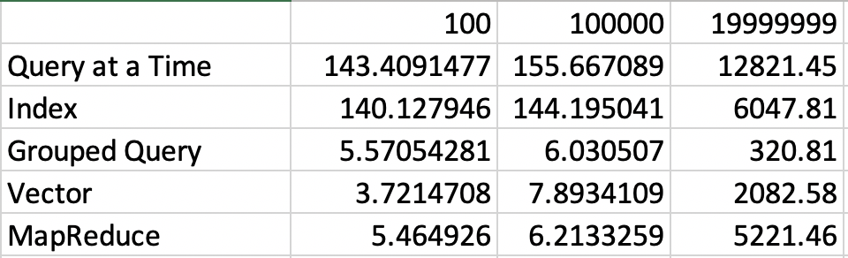
Conclusion
Using single CUBE Query for the whole workload of queries optimizes the time the most for running a large set of counting queries on a database.

